Slide 1

Data Warehousing & Data Mining(CSC496)
By
Mr. Usman Shehzaib
(Assistant Professor)
Department of Computer Science
CUI Lahore Campus

Slide 2
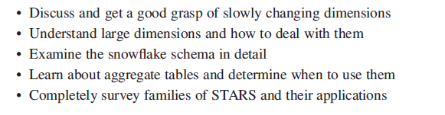
Dimensional Modeling Advanced Topics Objectives

Slide 3
Updates to Dimension Tables
Compared to the fact table, the dimension tables are more stable and less volatile. However, unlike the fact table, which changes through an increase in the number of rows, a dimension table does not change just through the increase in the number of rows, but also through changes to the attributes themselves.
Look at the product dimension table. Every year, rows are added as new models become available. But what about the attributes within the product dimension table? If a particular product is moved to a different product category, then the corresponding values must be changed in the product dimension table.

Slide 4
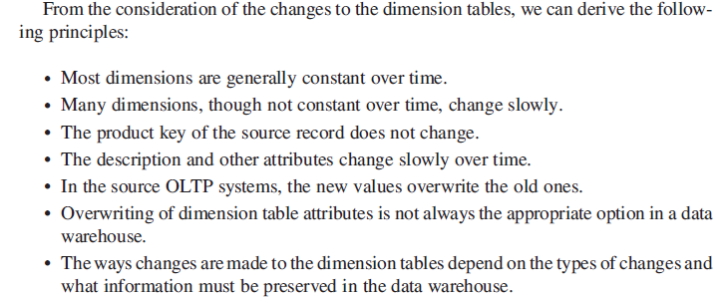
Slowly Changing dimensions

Slide 5
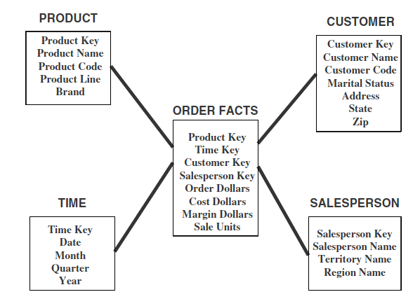
Updates to Dimension Tables

Slide 6
Updates to Dimension Tables (Cont.)
Techniques for making the changes fall into three distinct types. Data warehousing practitioners have come up with different techniques for applying the changes. They have also given names to these three types of dimension table changes
The given names are type 1 changes, type 2 changes, and type 3 changes.

Slide 7
Updates to Dimension Tables (Cont.)
Type-I changes: correction of errors, e.g., customer name changes from Sulman Khan to Salman Khan
Solution to type-I updates:
Simply update the corresponding attribute/attributes. There is no need to preserve their old values

Slide 8
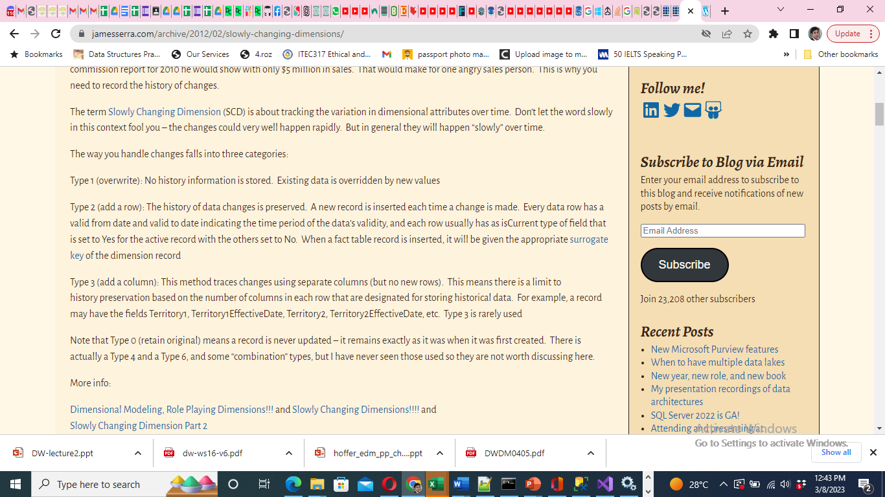

Slide 9
Updates to Dimension Tables (Cont.)
Here are the general principles for type 1 changes:
Usually, the changes relate to correction of errors in source systems.
Sometimes the change in the source system has no significance.
The old value in the source system needs to be discarded.
The change in the source system need not be preserved in the data warehouse.

Slide 10
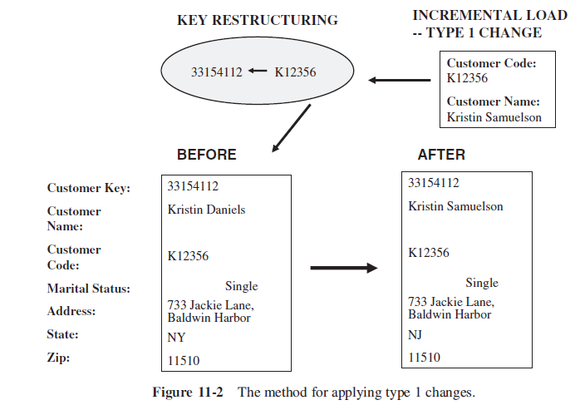
Applying Type 1 Changes

Slide 11
Type 2 changes: preserving history
For example change in “address” of a customer, but the user wants to see orders by geographic location then you can not simply update the address by replacing old value with new value, you need to preserve the history (old value) as well as need to insert new value

Slide 12
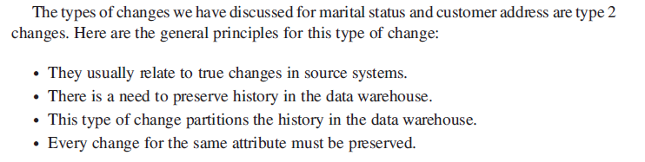
Type 2 changes: preserving history

Slide 13
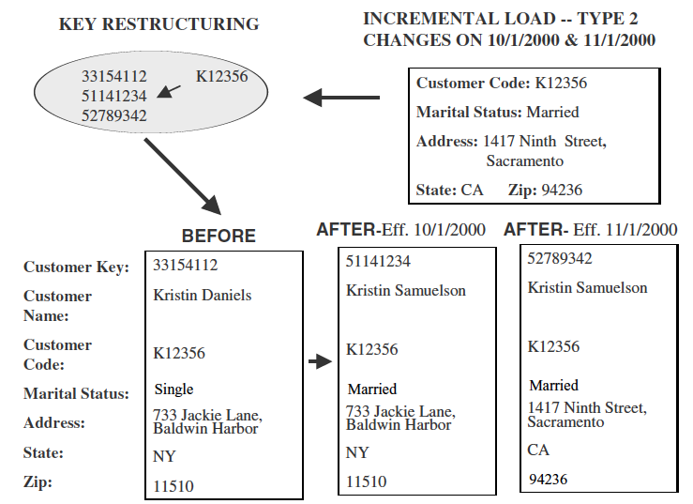
Updates to Dimension Tables (Cont.)
Proposed solution:

Slide 14
Updates to Dimension Tables (Cont.)
Type 3 changes: When you want to compare old and new values of attributes for a given period
Please note that in Type 2 changes the old values and new values were not comparable before or after the cut-off date (when the address was changed)

Slide 15
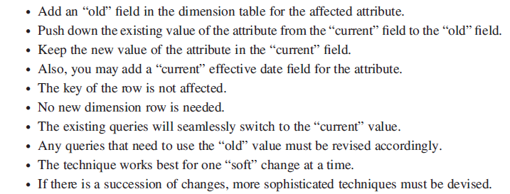
Updates to Dimension Tables (Cont.)

Slide 16
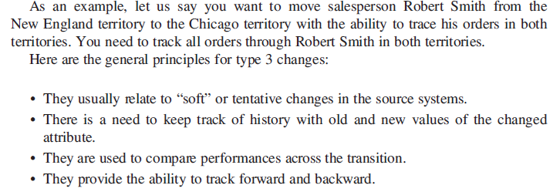
Updates to Dimension Tables (Cont.)

Slide 17
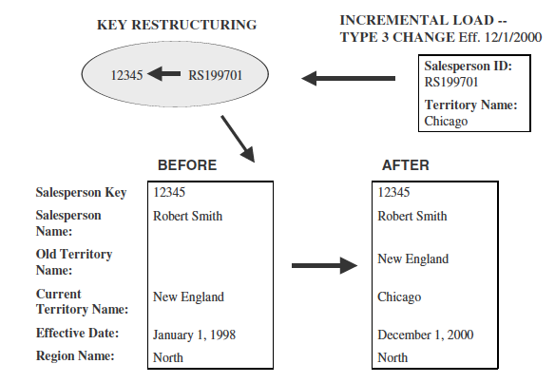
Updates to Dimension Tables (Cont.)
Solution: Add a new column of attribute

Slide 18
Updates to Dimension Tables (Cont.)
What if we want to keep a whole history of changes?
Should we add large number of attributes to tackle it?

Slide 19
Large Dimensions
A dimension is large based on two factors. A large dimension is very deep; that is, the dimension has a very large number of rows. A large dimension may also be very wide; that is, the dimension may have a large number of attributes or columns.
You may want to separate out some mini-dimensions from a large dimension.
In a data warehouse, typically the customer and product dimensions are likely to be large.

Slide 20
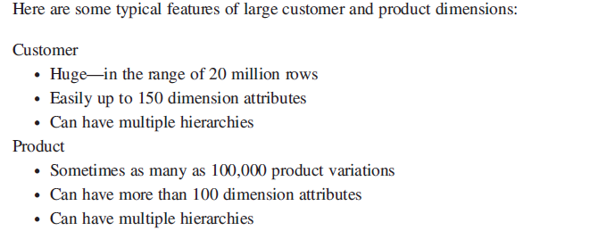
Large Dimensions

Slide 21
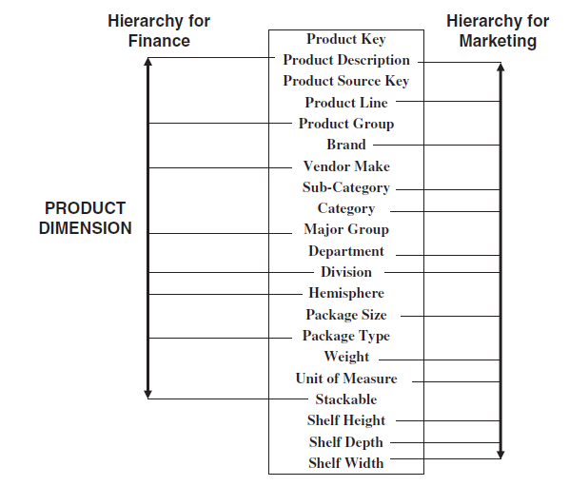
Multiple Hierarchies
Large dimensions usually possess another distinct characteristic.
They tend to have multiple hierarchies. Take the example of the product dimension for a
large retailer.

Slide 22
Rapidly Changing Dimension
When dimension’s records/rows are very large in numbers and changes are required frequently then Type-II change handling is not recommended
It is recommended to make a separate table of rapidly changing attributes

Slide 23
Rapidly Changing Dimension (Cont.)
“For example, an important attribute for customers might be their account status (good, late, very late, in arrears, suspended), and the history of their account status” [4]
“If this attribute is kept in the customer dimension table and a type 2 change is made each time a customer's status changes, an entire row is added only to track this one attribute” [4]
“The solution is to create a separate account_status dimension with five members to represent the account states” [4] and join this new table or dimension to the fact table.

Slide 24
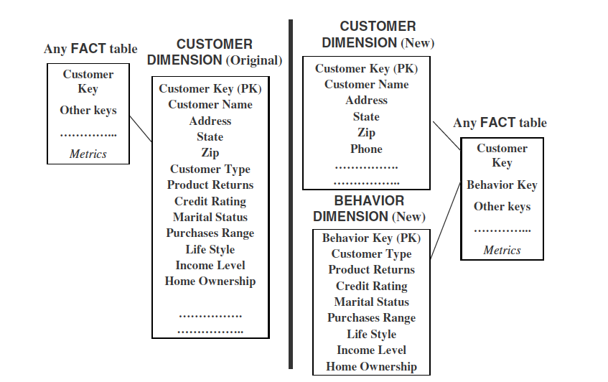
Example

Slide 25
Junk Dimensions
Sometimes there are some informative flags and texts in the source system, e.g., yes/no flags, textual codes, etc.
If such flags are important then make their own dimension to save the storage space
However, caution, if you have large number of combinations then make separate dimensions. For example, 5 attributes with 100 distinct values each. Total rows in it will be millions (100⁵). In this case make separate dimension for each attribute

Slide 26
Junk Dimensions
Exclude and discard all flags and texts. Obviously, this is not a good option, for the simple reason that you are likely to throw away some useful information.
Place the flags and texts unchanged in the fact table. This option is likely to swell up the fact table to no specific advantage.
Make each flag and text a separate dimension table on its own. Using this option, the number of dimension tables will greatly increase.
Keep only those flags and texts that are meaningful; group all the useful flags into a single junk dimension

Slide 27
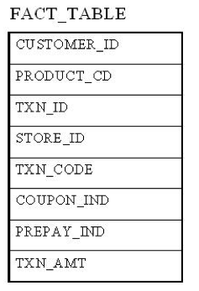
Junk Dimension Example [3]

Slide 28
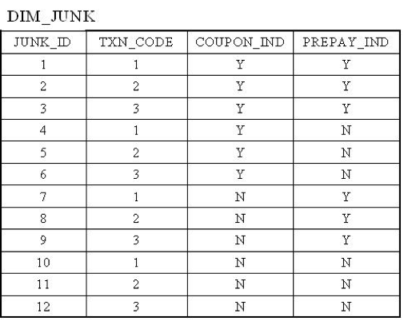
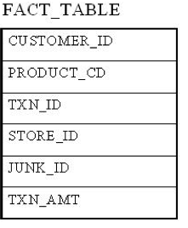
Junk Dimension Example (Cont.) [3]

Slide 29
Role-playing Dimensions
Dimensions are often recycled for multiple purposes within the same database. For instance, a “Date” dimension can be used for “Date of Sale”, as well as “Date of Delivery”, or “Date of Hire”. This is often referred to as a “role-playing dimension”.
Basically, if the same dimension is used more than once with different names then it is called the role- playing dimension. For example, suppose we are designing a cube which captures purchasing data, we can have multiple dates in this scenario like Order Date, Ship Date, Order Received Date, etc. In these kinds of situations we need to have different date keys stored in the fact tables (like OrderDateKey, ShipDateKey etc…) to get the different date information while browsing the cube.

Slide 30
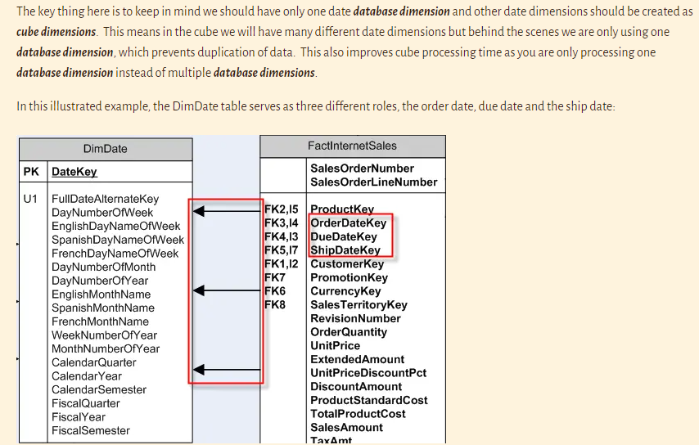
Role-playing Dimensions

Slide 31
Conformed dimensions
A conformed dimension is a dimension that has the same meaning to every fact with which it relates. Conformed dimensions allow facts and measures to be categorized and described in the same way across multiple facts and/or data marts, ensuring consistent reporting across the enterprise.
A conformed dimension can exist as a single dimension table that relates to multiple fact tables within the same data warehouse, or as identical dimension tables in separate data marts. Date is a common conformed dimension because its attributes (day, week, month, quarter, year, etc.) have the same meaning when joined to any fact table. A conformed product dimension with product name, description, SKU, and other common attributes could exist in multiple data marts, each containing data for one store in a chain.

Slide 32
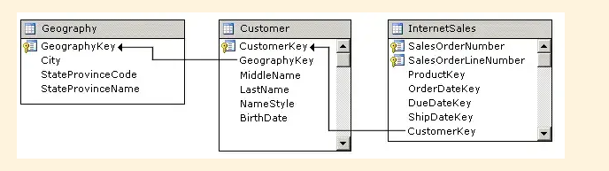
Reference Dimensions
A reference dimension occurs when the key column for the dimension is joined indirectly to the fact table through a key in another dimension table. This results in a snowflake schema design.
The following figure shows one fact table named InternetSales, and two dimension tables called Customer (regular or intermediate dimension) and Geography (reference dimension), in a snowflake schema:

Slide 33
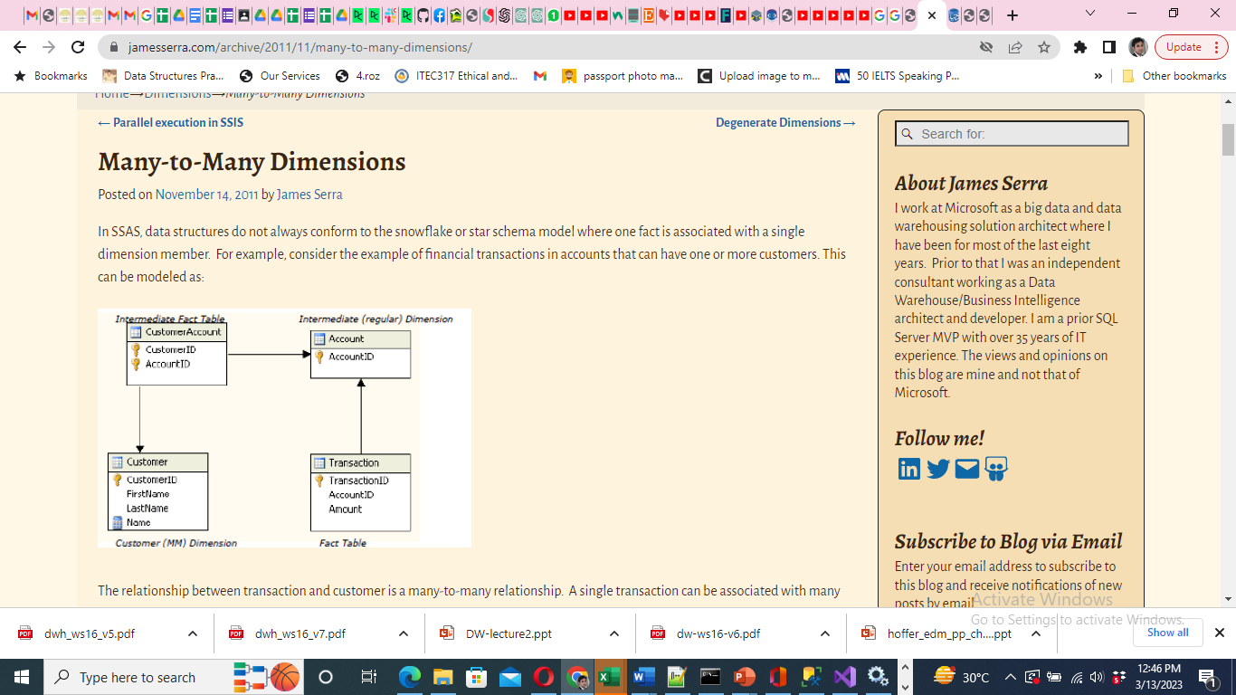
Many-to-Many Dimensions

Slide 34
Many-to-Many Dimensions
In the example picture above, there are two dimensions and two fact tables. The Customer dimension is the Many-to-Many (MM) dimension to the Transaction fact table. The CustomerAccount measure group is the Intermediate Fact Table (called a bridge table in the relational world) and Account is the intermediate dimension. The intermediate fact table is the fact table that relates the Many-to-Many dimension to the regular dimension. In this case, it relates the Customer dimension to Account dimension. The Transaction fact table is related to Customer in the conventional manner, but is also related to the Customer dimension via a many-to-many relationship.

Slide 35
The Snowflake Schema
Snowflacking involves normalization of dimensions in Star Schema
Reasons:
To save storage space
Easy maintenance of tables with low cardinality
However, some designers discourages it. According to them it is better to sacrifice storage space over performance and ease of use.

Slide 36
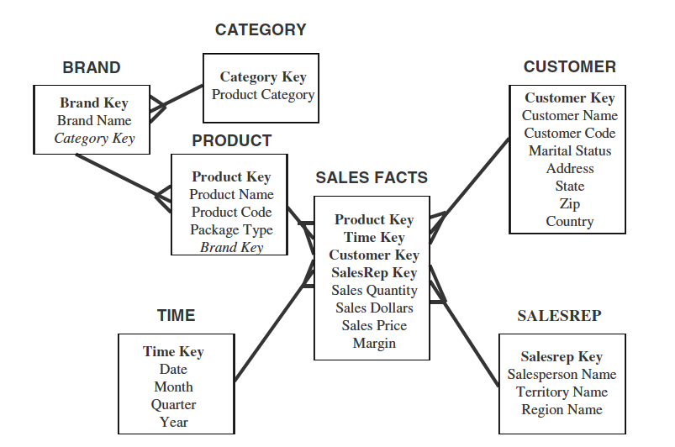
Example 1 of Snowflake Schema

Slide 37
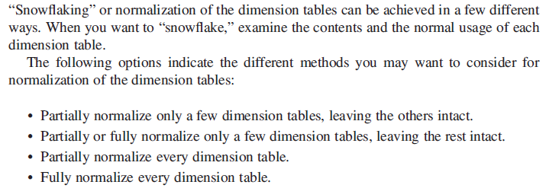
The Snowflake Schema

Slide 38
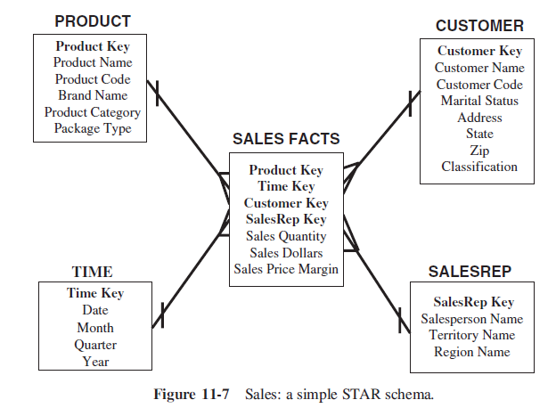
Sales original table

Slide 39
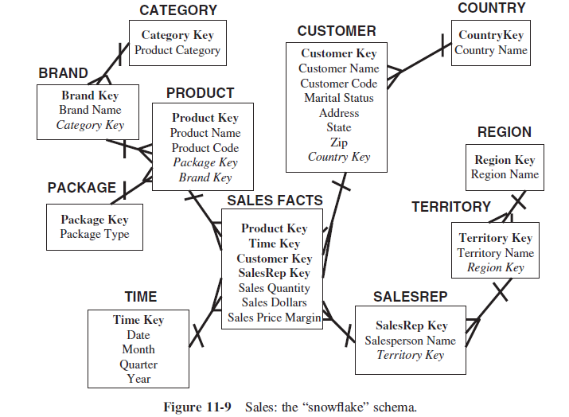
Sales Snowflake Schema

Slide 40
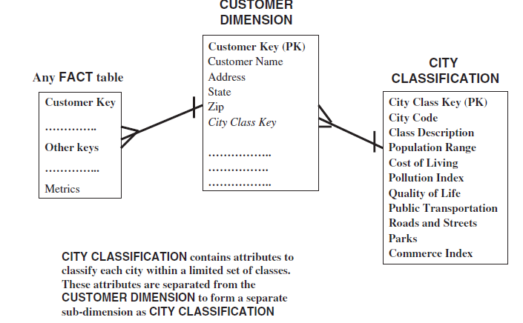
When to Snowflake

Slide 41
Sales: Snowflake Schema
Category key
Product category
Brand key
Brand name
Category key
Region key
Region name
Product key
Product name
Product code
Brand key
Territory key
Territory name
Region key
Sales fact
Product key
Time key
Customer key
….
Salesrep key
Salesperson name
Territory key
Product
Salesrep

Slide 42
Snowflaking
The attributes with low cardinality in each original dimension table are removed to form separate tables. These new tables are linked back to the original dimension table through artificial keys.
Product key
Product name
Product code
Brand key
Brand key
Brand name
Category key
Category key
Product category

Slide 43
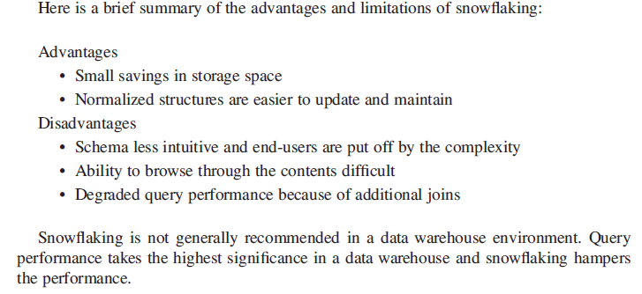
Advantages and disadvantages of Snowflake Schema

Slide 44
Aggregates
Add up amounts for day 1
In SQL: SELECT sum(amt) FROM SALE
WHERE date = 1
81

Slide 45
Aggregates
Add up amounts by day
In SQL: SELECT date, sum(amt) FROM SALE
GROUP BY date

Slide 46
Another Example
Add up amounts by day, product
In SQL: SELECT date, sum(amt) FROM SALE
GROUP BY date, prodId
rollup
drill-down

Slide 47
Aggregates
Operators: sum, count, max, min, median, ave
“Having” clause
Using dimension hierarchy
average by region (within store)
maximum by month (within date)

Slide 48
Aggregate Fact Tables
Aggregates are precalculated summaries derived from the most granular fact table. These summaries form a set of separate aggregate fact tables.
You may create each aggregate fact table as a specific summarization across any number of dimensions.
Use aggregate fact tables when too many rows of fact tables are involved in making summary of required results
Objective is to reduce query processing time

Slide 49
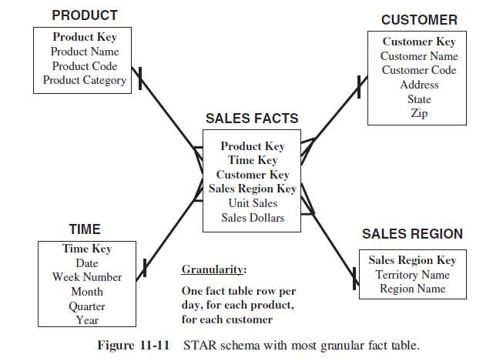
Aggregate Fact Tables

Slide 50
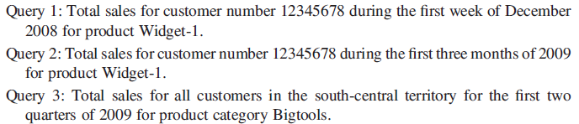
Aggregate Fact Tables

Slide 51
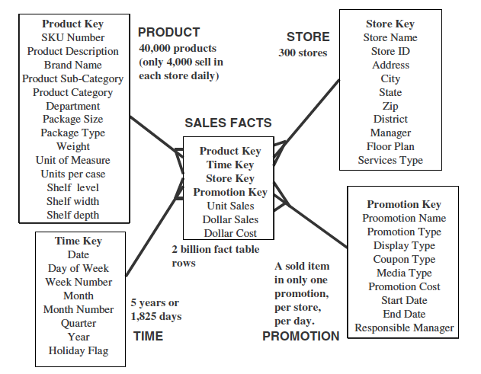
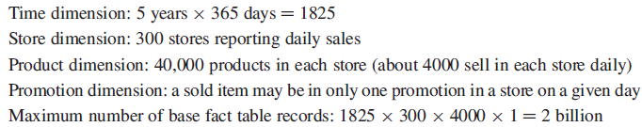
Fact Table Sizes

Slide 52
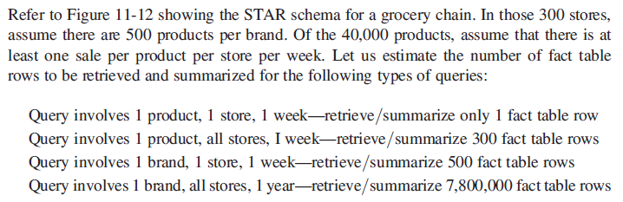
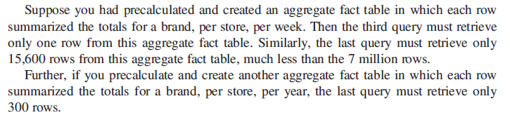
Need for Aggregates

Slide 53
Solution
Make aggregate fact tables, because you might be summing some dimension and some might not then why we should store the dimensions that do not need highest level of granularity of details.
For example: Sales of a product in a year OR
total number of items sold by category on daily basis

Slide 54
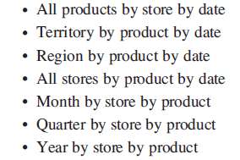
Multi Way aggregate fact tables
One Way Aggregates: When you rise to higher levels in the hierarchy of one dimension and keep the level at the lowest in the other dimensions, you create one-way aggregate tables.Review the following examples:

Slide 55
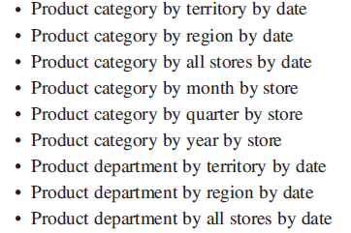
Multi Way aggregate fact tables
Two Way Aggregates:When you rise to higher levels in the hierarchies of two dimensions and keep the level at the lowest in the other dimension, you create two-way aggregate tables. Review the following examples:

Slide 56
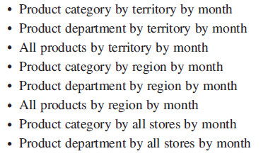
Multi Way aggregate fact tables
Three Way Aggregates: When you rise to higher levels in the hierarchies of all the three dimensions, you create three-way aggregate tables. Review the following examples

Slide 57
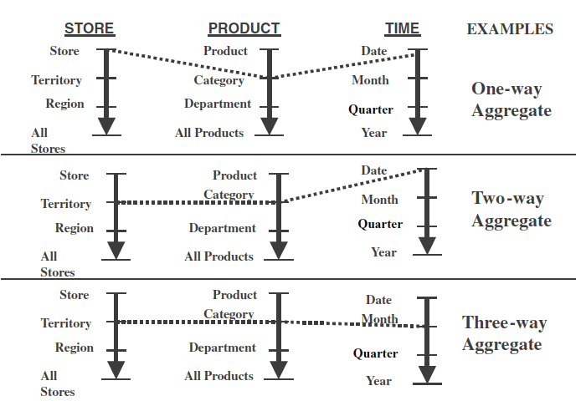
A way of making aggregates
Example:

Slide 58
Making Aggregates
But first determine what is required from your data warehouse then make aggregates

Slide 59
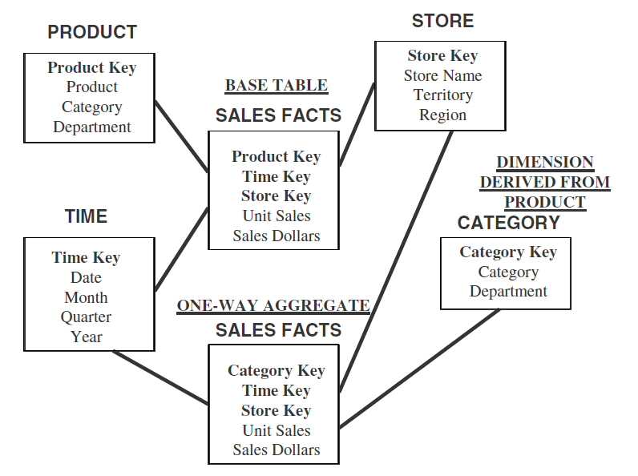
Example of Aggregate Fact Table

Slide 60
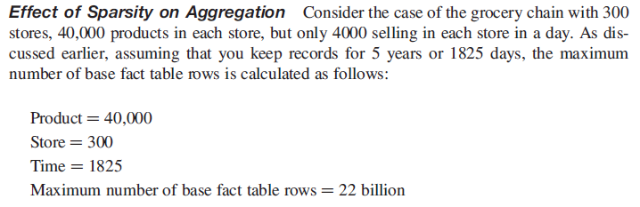
Effect of sparsity on Aggregates
Because only 4000 products sell in each store in a day, not all of these 22 billion rows are occupied. Because of this sparsity, only 10% of the rows are occupied. Therefore, the real estimate of the number of base table rows is 2 billion.

Slide 61
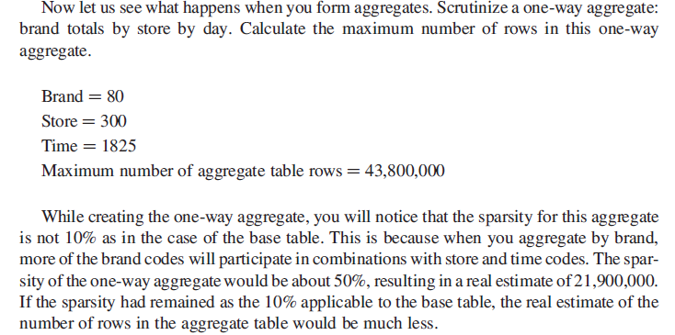
Effect of sparsity on Aggregates
Experienced data warehousing practitioners have a suggestion. When you form aggregates,
make sure that each aggregate table row summarizes at least 10 rows in the lower
level table. If you increase this to 20 rows or more, it would be really remarkable.

Slide 62
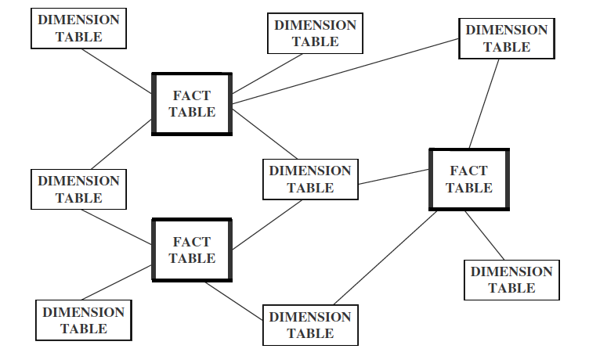
Families of Stars

Slide 63
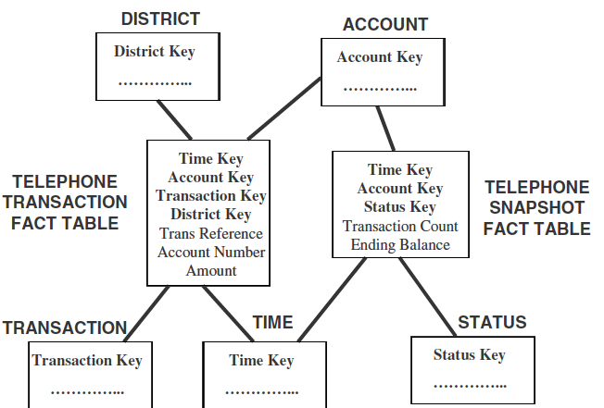
Families of Stars (Cont.)
Transaction (day to day) and snapshot tables (data after some specific intervals)

Slide 64
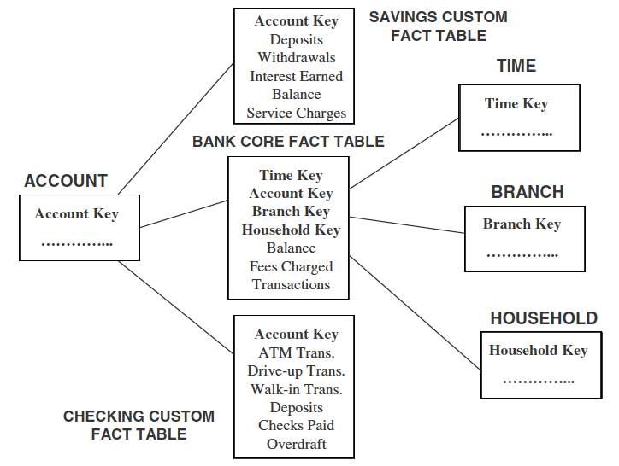
Families of Stars (Cont.)
Core and custom tables

Slide 65
Families of Stars (Cont.)
Conformed Dimension: The attributes of a dimension must have the same meaning for all those fact tables with which the dimension is connected.

